Slide 1
Data Visualization Using Plotly Package (Python)
By: Lara Baltaji

Slide 2
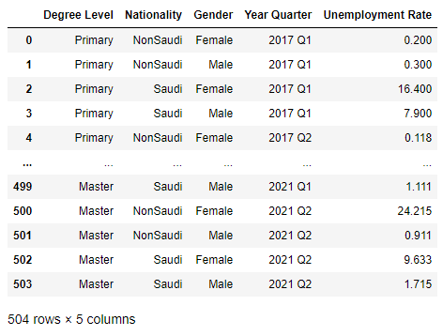
About the Dataset:
The dataset that was used for plotting the visualizations was taken from Kaggle, an online data science platform that provides free-to-download datasets, data science courses, codes and much more. The dataset shows the unemployment rates per education level, nationality and gender. The source is GASTAT. The data was taken from 18 different files from the first quarter of 2017 till the second quarter of 2021.

Slide 3
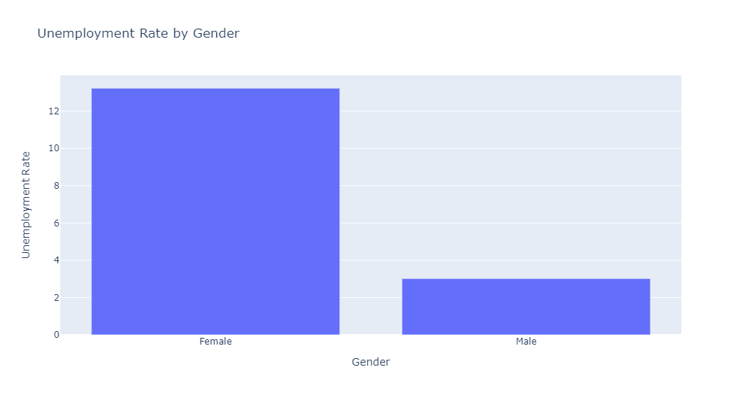
Bar Plot: Unemployment Rate by Gender

Slide 4
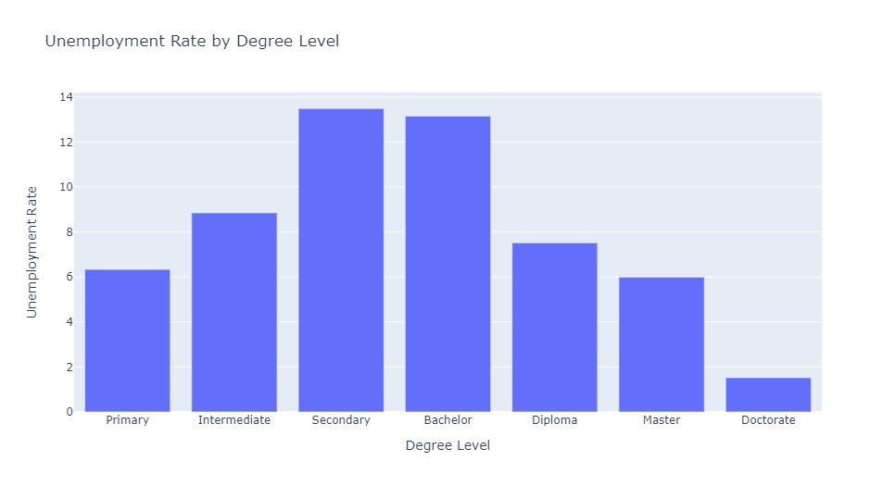
Bar Plot: Unemployment Rate by Degree Level

Slide 5
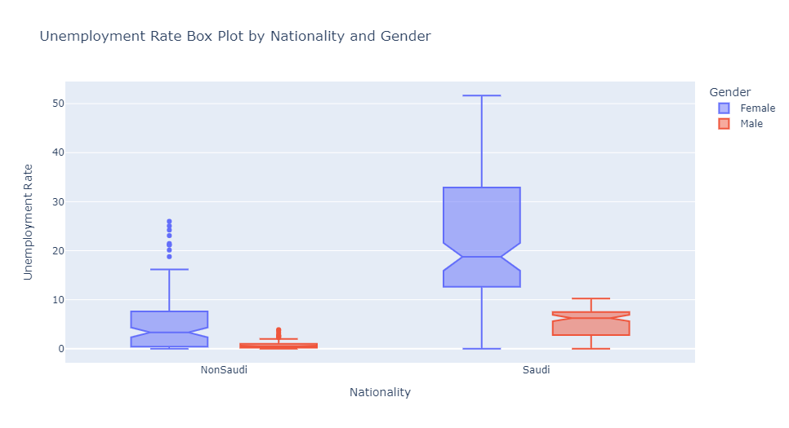
Box Plot: Unemployment Rate by Nationality and Gender

Slide 6
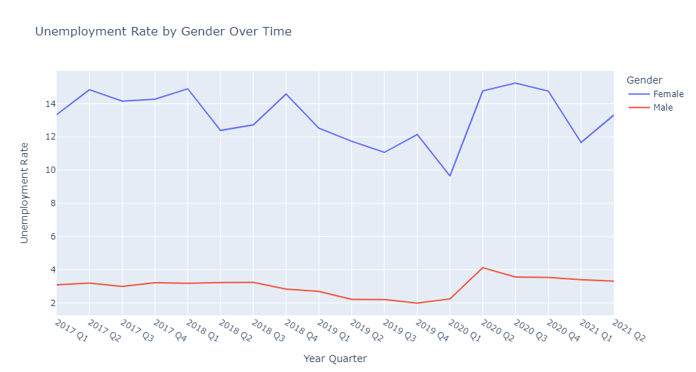
Line Plot: Unemployment Rate by Gender Over Time

Slide 7
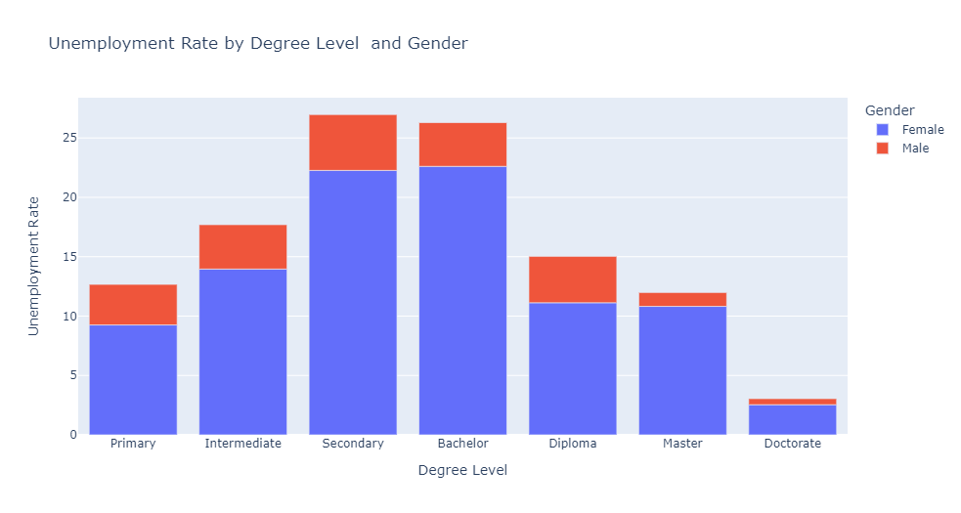
Bar Plot: Unemployment Rate by Degree Level and Gender

Slide 8
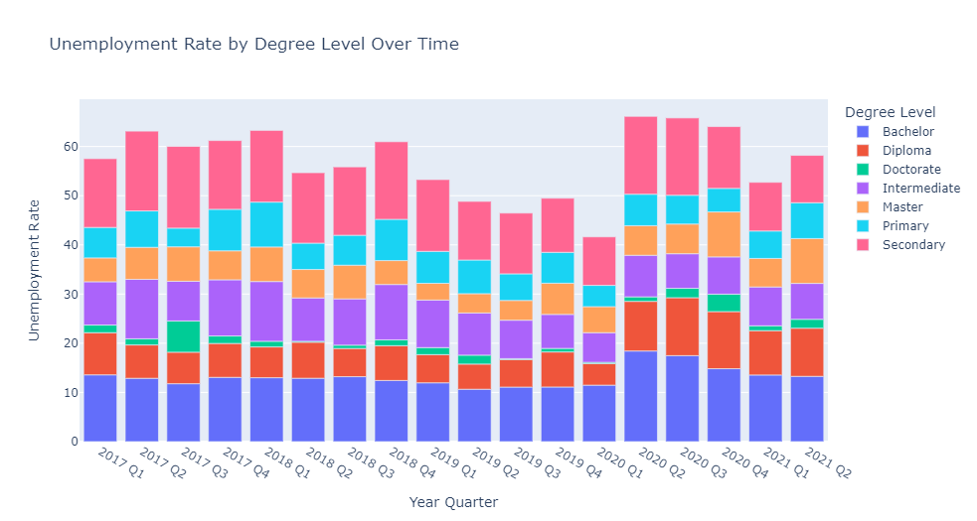
Bar Plot: Unemployment Rate by Degree Level Over Time

Slide 9
Thank You!

